Slide 1
IBM Watson Studio

Slide 2
Introduction
IBM Watson Studio is a cloud-based data science platform that provides an integrated environment for developing, deploying, and managing AI and data science applications. It offers a comprehensive set of tools and services to streamline the data science process, from data collection and preparation, to model building and deployment.
Today we will do the following:
Create a new Watson ml instance
Use Watson studio to deploy both our notebook and in extension our model
Use the provided code snippet to deploy our model with streamlit

Slide 3
Prerequisite
Final notebook.ipynb
Mobile.py
Login access to IBM cloud
Datasets(train & test)

Slide 4
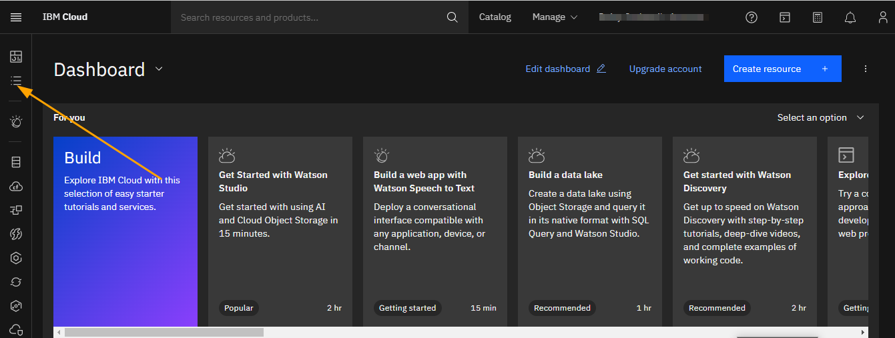
Guiding steps
When you first log in to IBM cloud you and greeted with a dashboard. Here we navigate first to create resources for out project and later use them for deployment purposes.

Slide 5
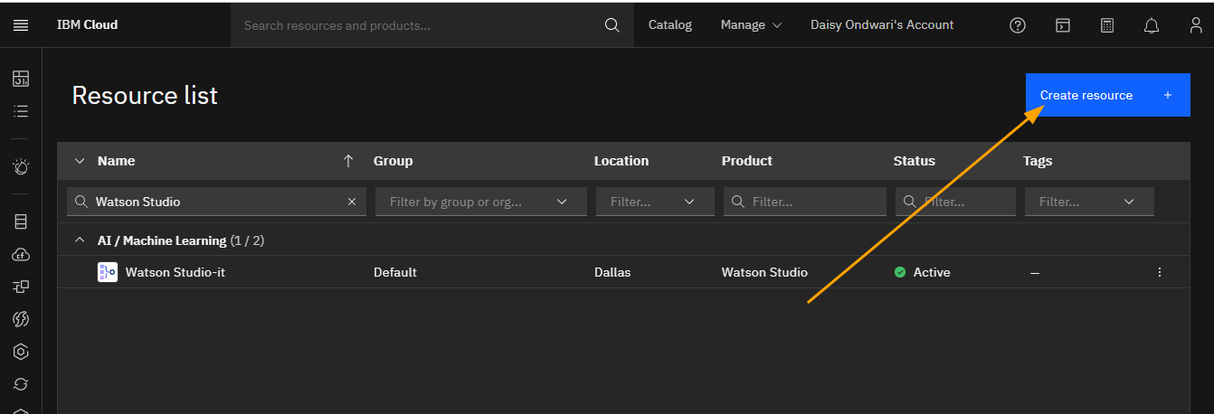
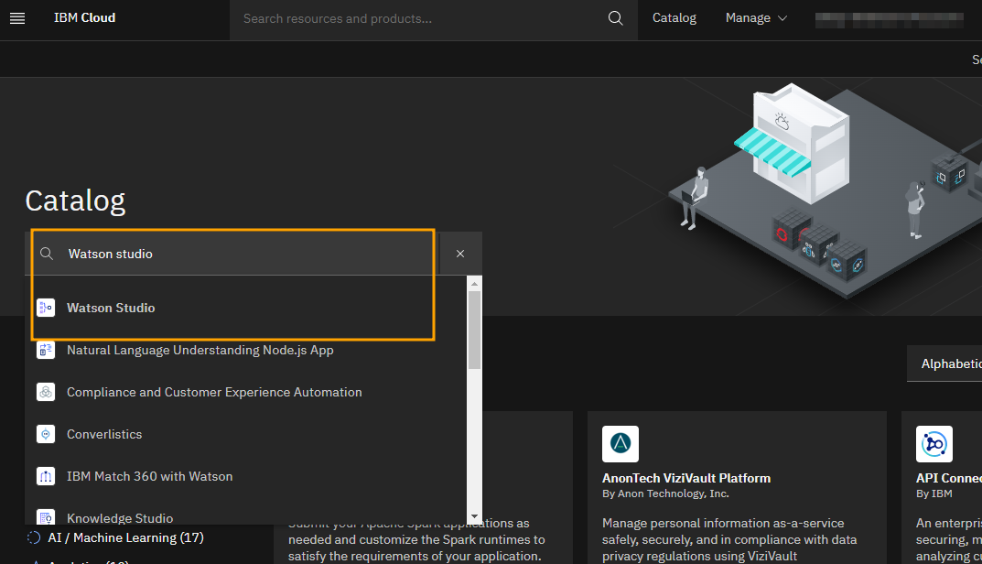
Here we create a new Watson studio instance

Slide 6
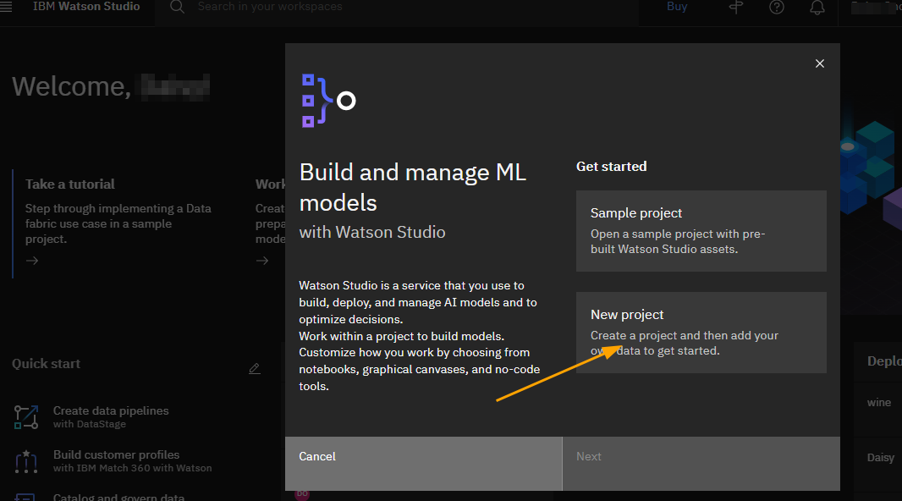

Slide 7
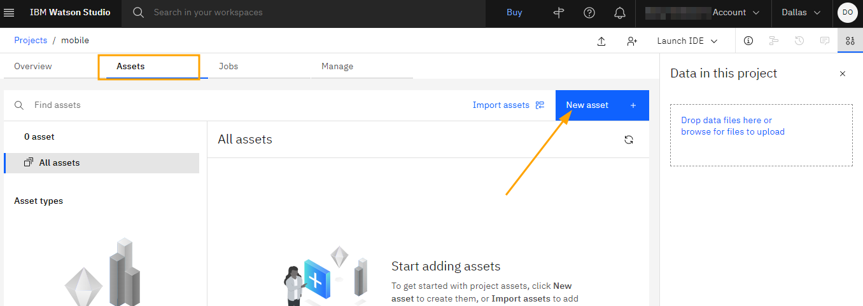
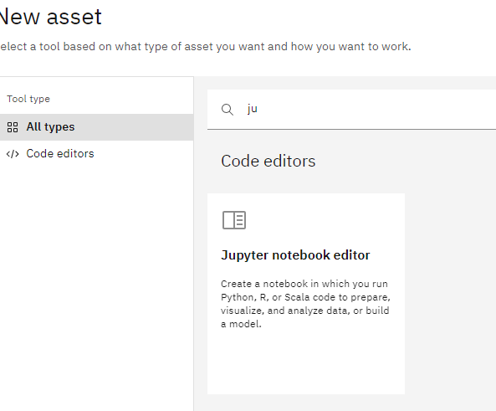
Now in the assets tab, we create a new asset and we will first start with a base notebook shared.

Slide 8
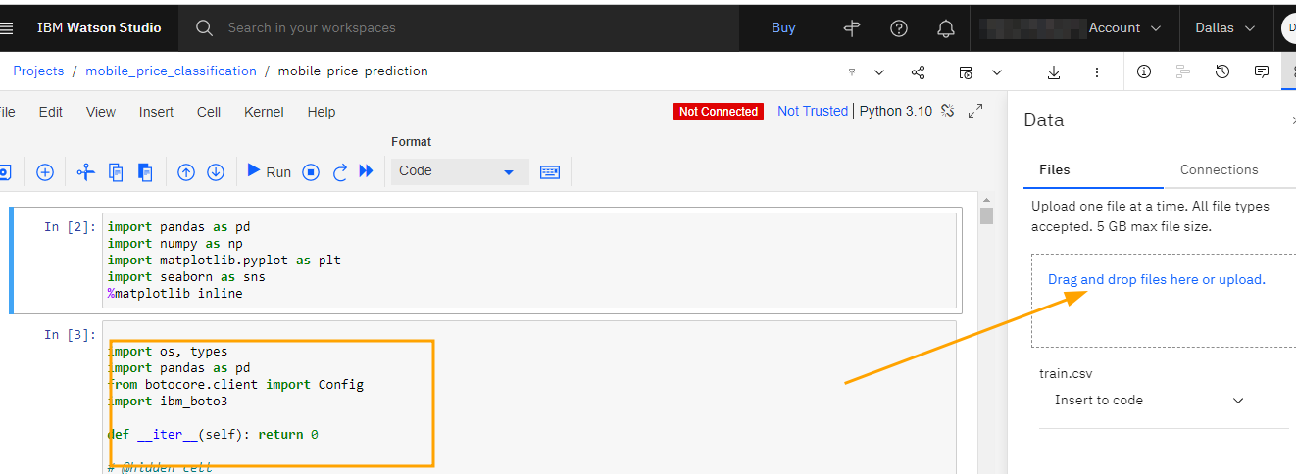
After uploading the notebook you’ll need to make some few modifications, here we will first change how we will load the data into the notebook.in the top right there will be an binary like icon to add our training dataset as an asset. After adding, click on “insert into code” to add it to an empty cell.

Slide 9

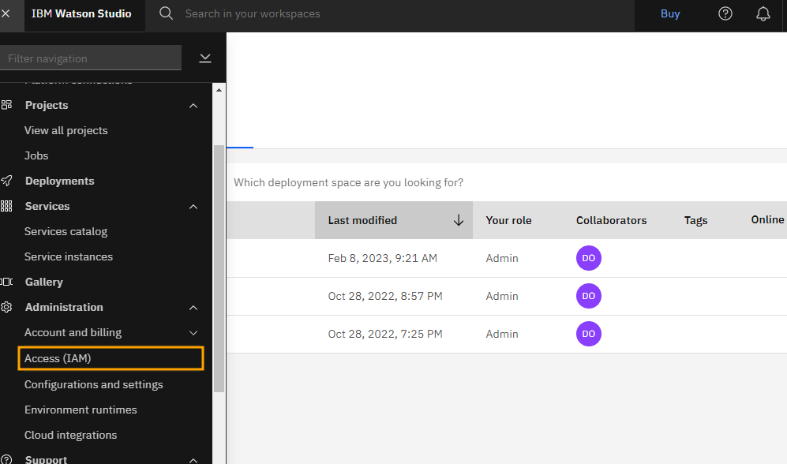
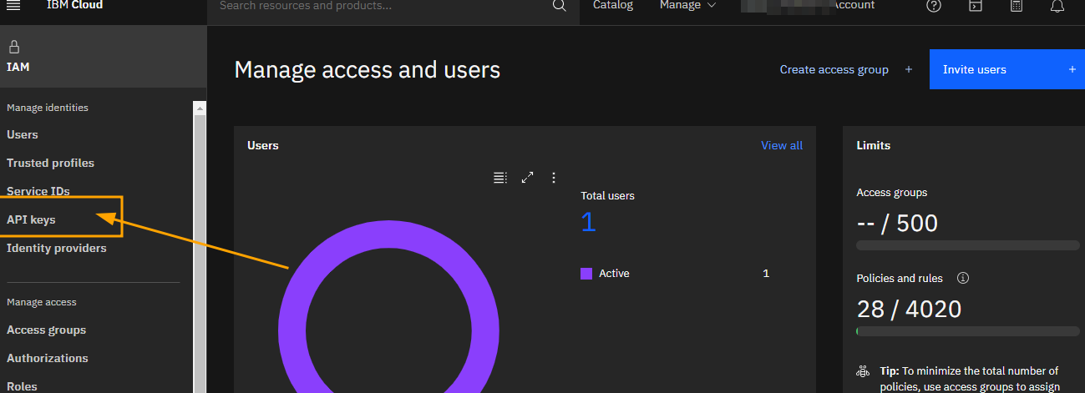
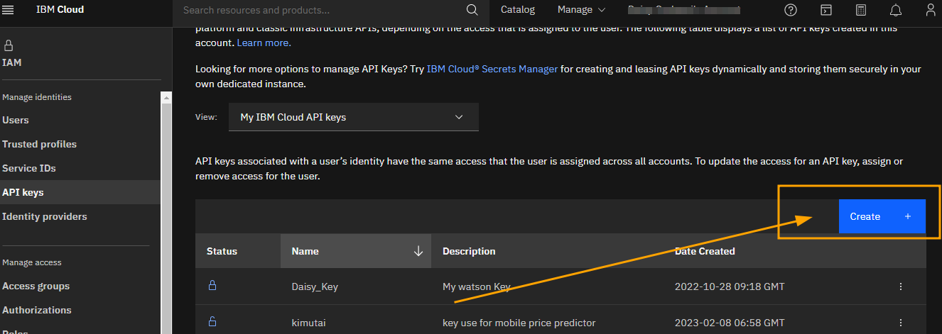
secondly we will need to create and add a user unique API key for your notebook and URL (but if you created the resource using the Dallas region no change needed to the URL).

Slide 10
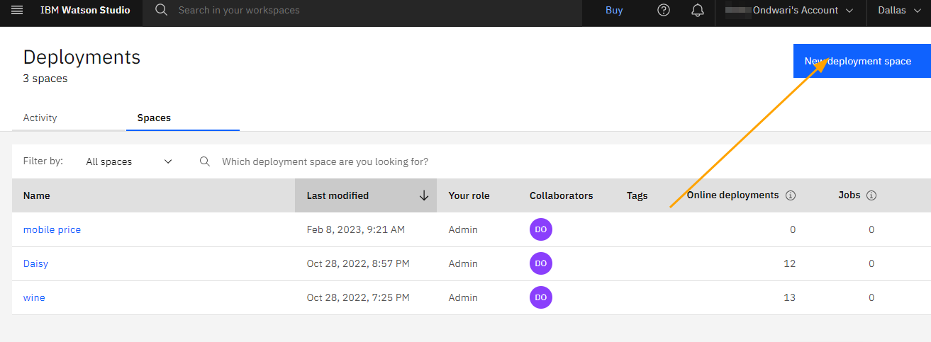
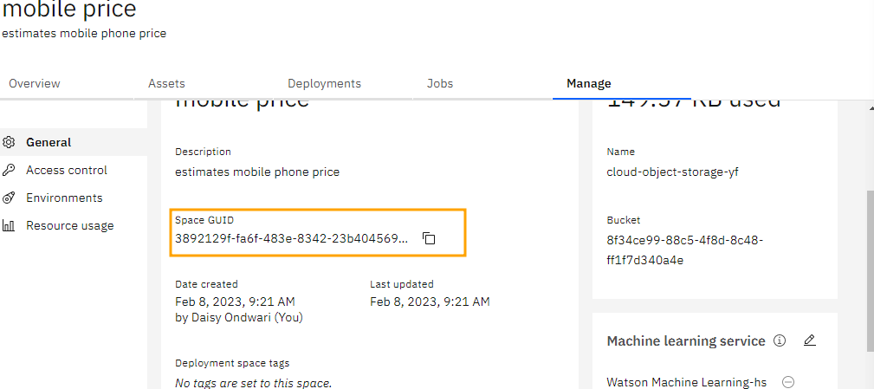
Similar to API key we will also change the space _id
- We first create a deployment space and in the manage tab copy the space_id into your notebook

Slide 11
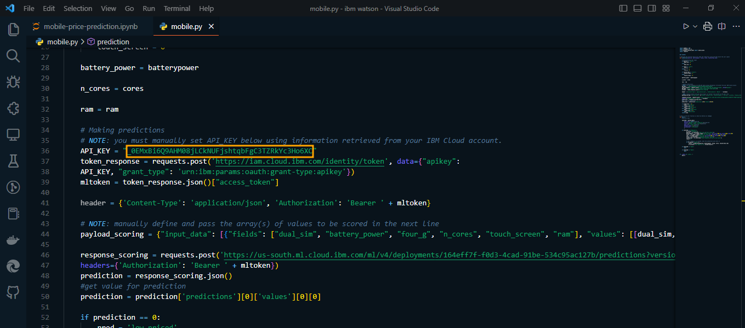
Next, in your IDE preferably VS code open the mobile.py file and change the API_KEY variable to have the value similar to the one you used in your deployed notebook.

Slide 12
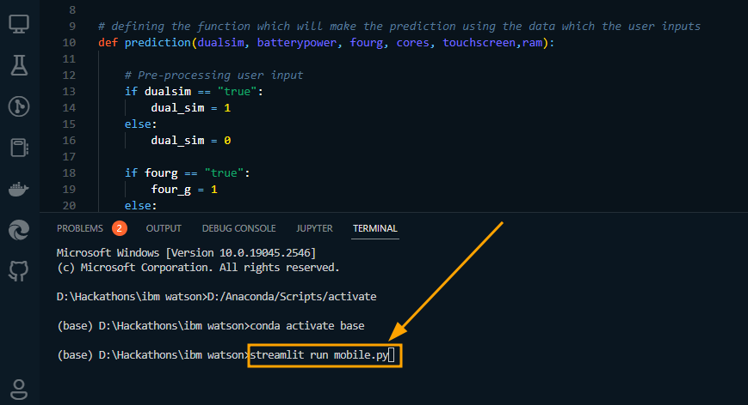
Finally we will test this app on your local machine by running the command :
Streamlit run mobile.py
NB: this will run properly as long as you have installed the following libraries with pip in your python environment :
pip install streamlit_option_menu
pip install streamlit
pip install pandas

Slide 13
Questions & answers
questions from the audience

